Slide 1
ACCOUNT MANAGEMENT SYSTEM
B. PRIYA HASINI-24KB1A3014
01/05/2025

Slide 2
INTRODUCTION
PURPOSE:
To Implement a basic yet functional system for creating, managing, and securing user accounts using C programming.
SCOPE:
The program allows users to create accounts, log in, change passwords, and delete accounts.
Admin Funtionality includes unlocking accounts after multiple failed login attempts.
TECHNOLOGY USED:
Programming Language: C
Concepts Applied: Arrays, Strings, Structures, Functions, Loops, Conditional statements.

Slide 3
LIMITATIONS AVOIDED:
The program does not use pointers, file handling, or Conio.h, making it suitable for beginner-level C Learners.
SECURITY FEATURES:
Password protection for each account.
Account lock after 3 failed login attempts.
Manual account unlock by an admin.
USER INTERACTION:
Menu-driven interface that operates in a loop until the user chooses to exit.
EDUCATIONAL VALUE:
Helps understand real-world applications of Structures, Conditionals, loops, and string operations in C.

Slide 4
OBJECTIVES
To implement a Secure and Simple user Authentication System.
To Apply C programming concepts to a real-world application.
To simulate features like login attempt tracking and account locking.
To simulate real-world account handling such as login Authentication, account locking after failed attempts, and password management in a simple C environment.

Slide 5
Features
ACCOUNT CREATION:
Users can create a new account by entering a unique User ID and Password.
LOGIN:
Users must enter the correct credentials. If the password is entered incorrectly three times, the account gets locked.
CHANGE PASSWORD:
After logging in, users are optionally allowed to update their password.
DELETE ACCOUNT:
A user can delete their account by providing valid credentials.
ACCOUNT LOCK AND UNLOCK:
The account is automatically locked after 3 failed login attempts. The admin(user running the system)can unlock it.
DISPLAY ACCOUNTS:
The system can display all user accounts with their current status(Active/Locked).

Slide 6
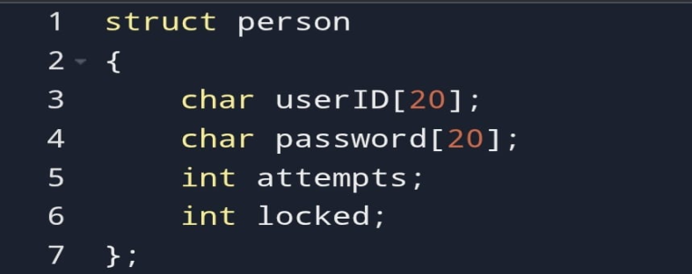
TECHNICAL DETAILS
PROGRAMMING LANGUAGE: C
DATA STORAGE: Static array of Structures (Max 10 accounts).
STURCTURE USED:
FUNCTIONS IMPLEMENTED:
Create()—Adds a new user
Login()—Authenticates user, tracks attempts
ChangePass()—Updates Password
Deletee()—Removes user after validation
Display()—Lists accounts and their status
UnlockAcct()—Unlocks locked accounts

Slide 7
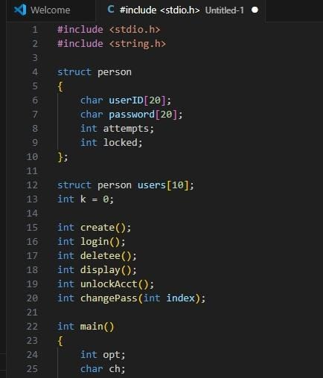
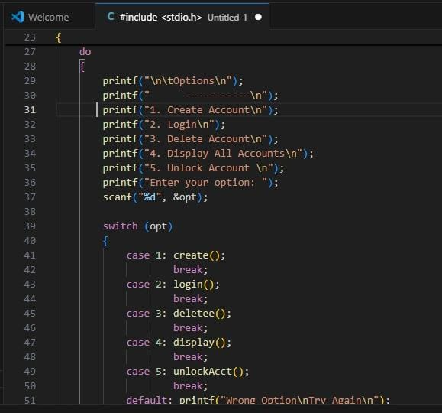
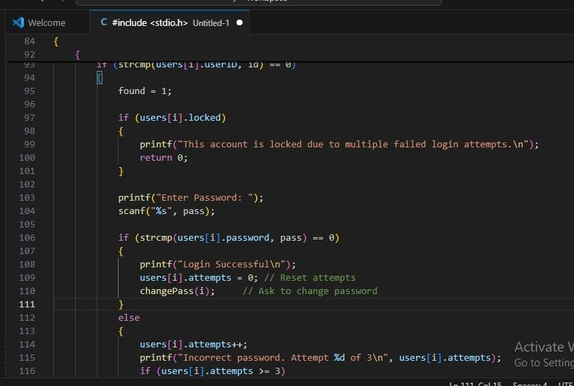
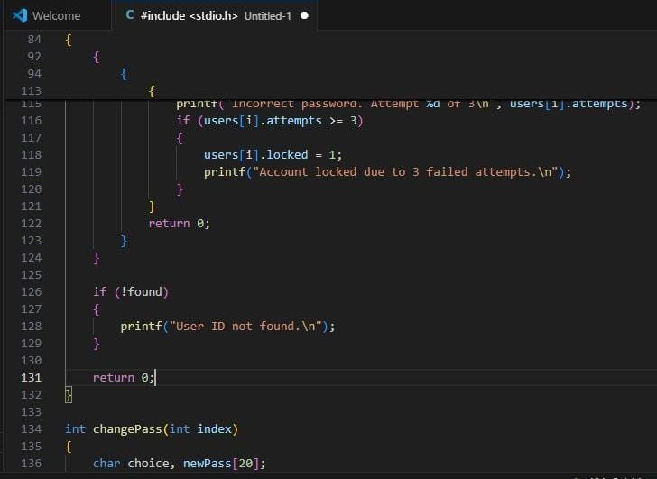
Source code

Slide 8
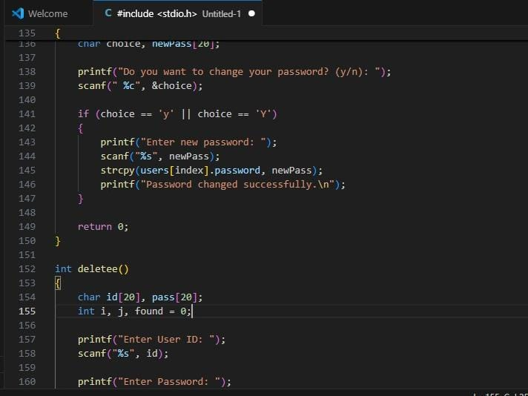
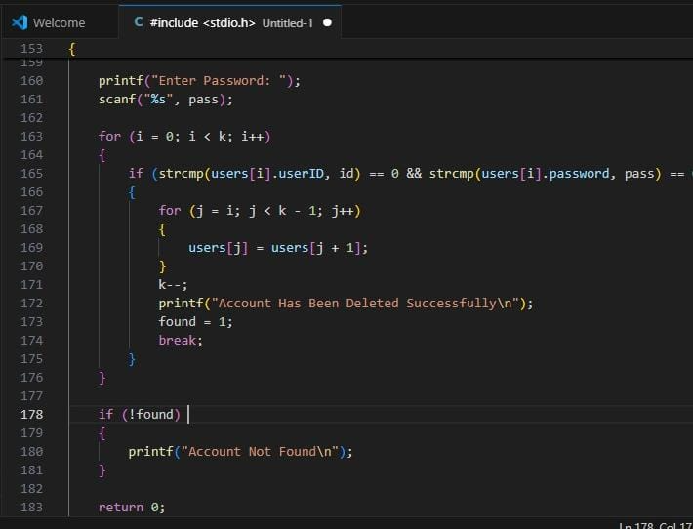
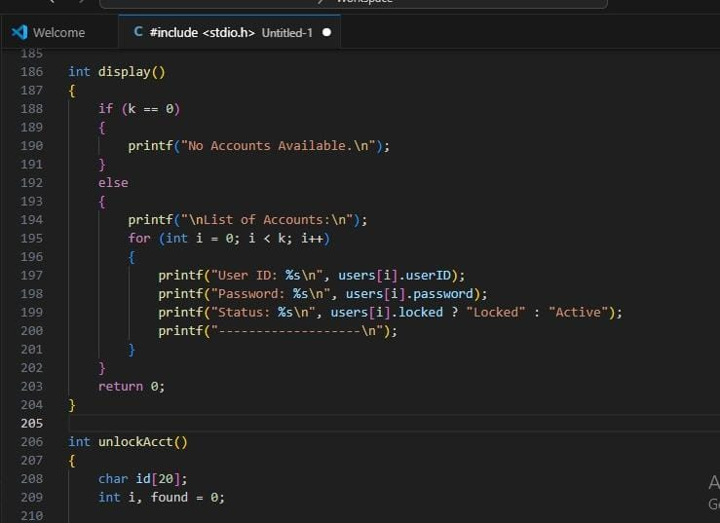
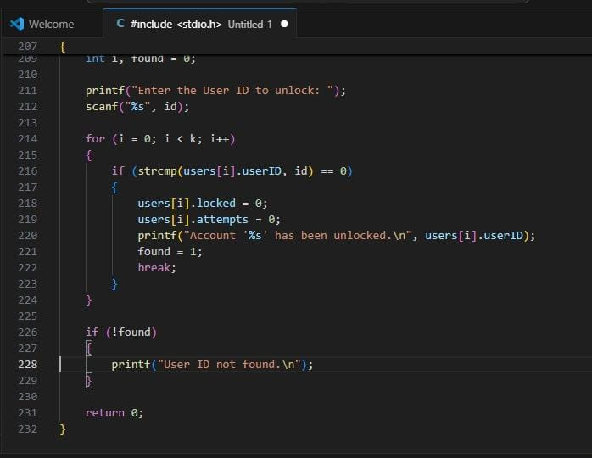

Slide 9
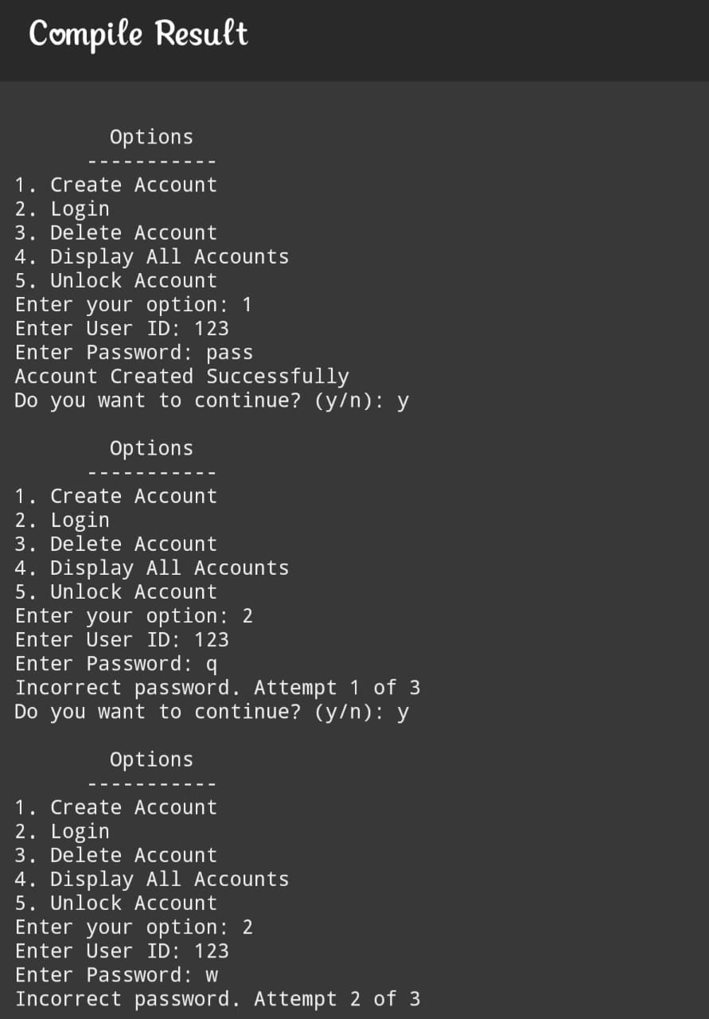
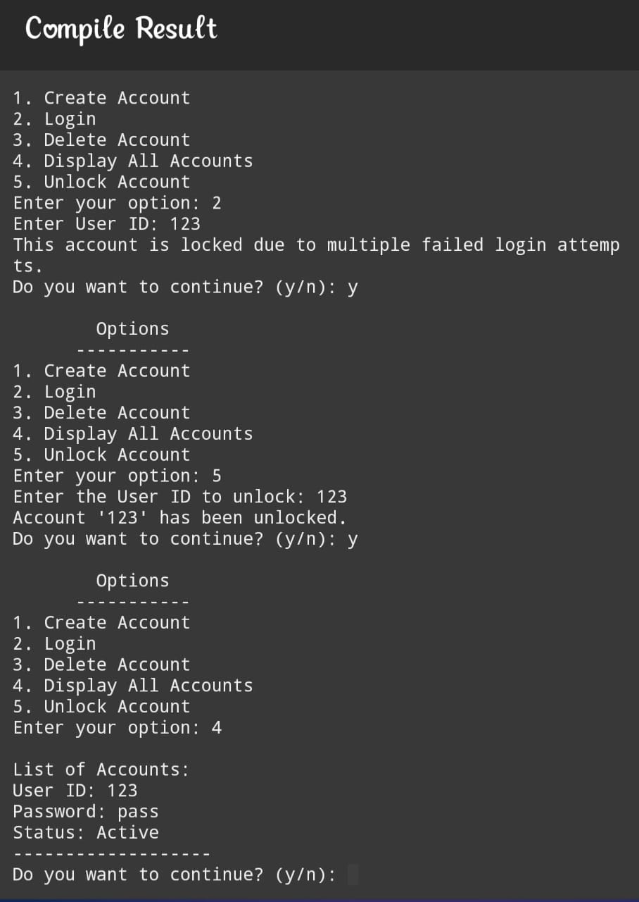
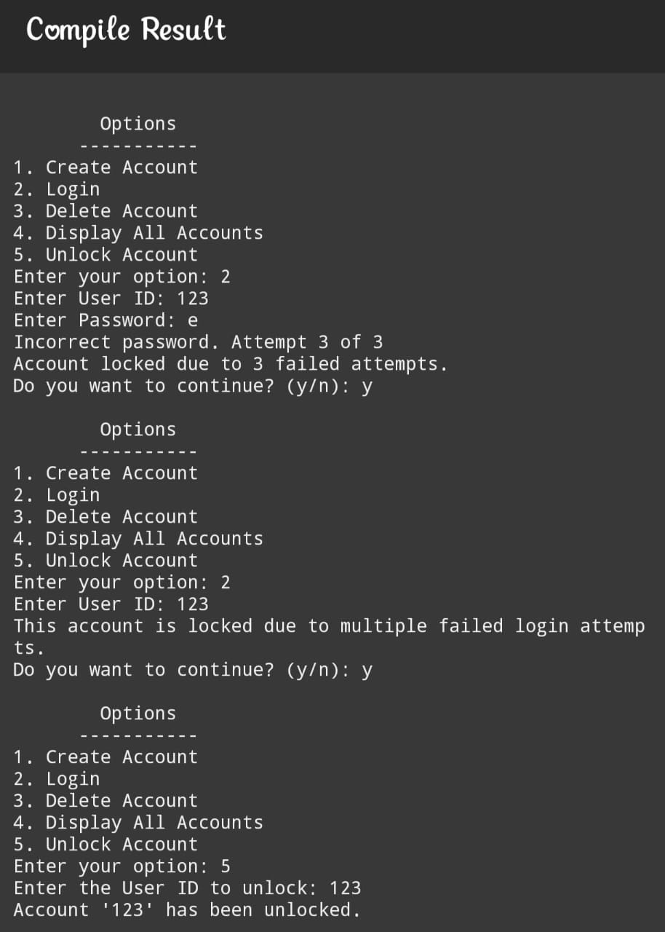
Sample output

Slide 10
LIMITATIONS
No File storage(all data lot on program exit).
Passwords visible during entry(not masked).
No Password recovery feature.
FUTURE ENHANCEMENTS
Use of time.h to log account creation time.
Password input using asterisks without conio.h.
Storing data in a file for persistence.
Admin login for more security.

Slide 11
conclusion
Successfully implemented a basic account management system using core C concepts.
Demonstrated secure login by incorporating password verification and lockout after failed attempts.
Improved user safety through manual unlocking and password change options.
Provided pratical experience with arrays, strings, structures, and conditional in real-world scenarios.
User-Friendly interface ensures ease of use and understanding for new programmers.

Slide 12


